Slide 1
Object oriented programming
UNIT-4

Slide 2
Introduction
Object Oriented Programming is a way of computer programming using the idea of “objects” to represents data and methods.
It is also, an approach used for creating neat and reusable code instead of a redundant one.
the program is divided into self-contained objects or several mini-programs.
Every Individual object represents a different part of the application having its own logic and data to communicate within themselves.

Slide 3
OOP Vs POP
Object-Oriented Programming (OOP) | Procedural-Oriented Programming (Pop)
It is a bottom-up approach | It is a top-down approach
Program is divided into objects | Program is divided into functions
Makes use of Access modifiers ‘public’, private’, protected’ | Doesn’t use Access modifiers
It is more secure | It is less secure

Slide 4
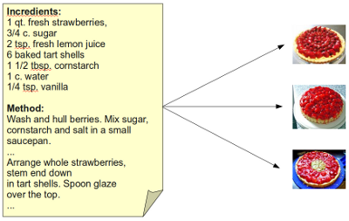
Ex: CAKE CLASS

Slide 5
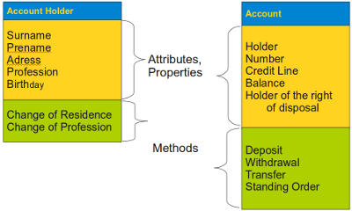
Example Classes

Slide 6
Class:
Defines a blueprint for creating an object. Think of a builder who wants to create a building of some type. The builder uses a blueprint to ensure that the building will meet the required specifications. Likewise, Python uses classes as a blueprint for creating new objects.
Class variable:
Provides a storage location used by all methods in an instance of the class. A class variable is defined within the class proper but outside of any of the class methods.
Class variables aren’t used very often because they’re a potential security risk — every method of the class has access to the same information.
Data member:
Defines either a class variable or an instance variable used to hold data associated with a class and its objects.

Slide 7
Instance:
Defines an object created from the specification provided by a class. Python can create as many instances of a class to perform the work required by an application. Each instance is unique.
Instance variable:
Provides a storage location used by a single method of an instance of a class. The variable is defined within a method. Instance variables are considered safer than class variables because only one method of the class can access them. Data is passed between methods using arguments, which allows for controlled checks of incoming data and better control over data management.
Instantiation:
Performs the act of creating an instance of a class. The resulting object is a unique class instance.

Slide 8
Method:
Defines the term used for functions that are part of a class. Even though function and method essentially define the same element, method is considered more specific because only classes can have methods.
Object:
Defines a unique instance of a class. The object contains all the methods and properties of the original class. However, the data for each object differs. The storage locations are unique, even if the data is the same.

Slide 9
Features of OOP
Function overloading:
Creates more than one version of a function, which results in different behaviors. The essential task of the function may be the same, but the inputs are different and potentially the outputs as well. Function overloading is used to provide flexibility so that a function can work with applications in various ways.
Inheritance:
Uses a parent class to create child classes that have the same characteristics. The child classes usually have extended functionality or provide more specific behaviors than the parent class does.

Slide 10
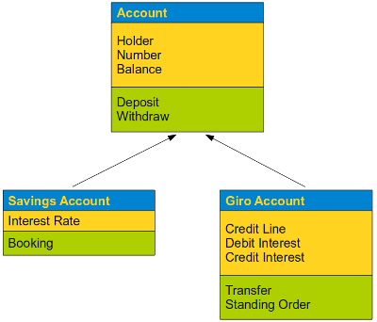
Inheritance

Slide 11
Operator overloading:
Creates more than one version of a function that is associated with an operator such as: +, -, /, or *, which results in different behaviors. The essential task of the operator may be the same, but the way in which the operator interacts with the data differs. Operator overloading is used to provide flexibility so that an operator can work with applications in various ways.
Encapsulation
Generally speaking encapsulation is the mechanism for restricting the access to some of an object's components, this means that the internal representation of an object can't be seen from outside of the objects definition.

Slide 12
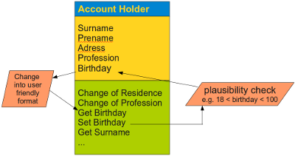
Encapsulation

Slide 13
Polymorphism:
You all must have used GPS for navigating the route, Isn’t it amazing how many different routes you come across for the same destination depending on the traffic, from a programming point of view this is called ‘polymorphism’.
It is one such OOP methodology where one task can be performed in several different ways.
To put it in simple words, it is a property of an object which allows it to take multiple forms.

Slide 14
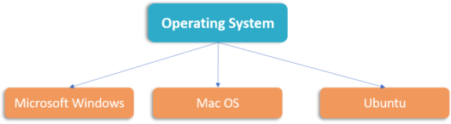
Polymorphism (Function & operator overloading)

Slide 15
Creating Class
Class:
We use the class keyword to define the data and code that will make up each of the objects. The class keyword includes the name of the class and begins an indented block of code where we include the attributes (data) and methods (code).
Syntax:
class <classname>:
Data members = value
…….
Member functions:
……..
Example:
class PartyAnimal:
x = 0
def party(self) :
self.x = self.x + 1
print("So far",self.x)
an = PartyAnimal()
an.party()
an.party()
an.party()

Slide 16
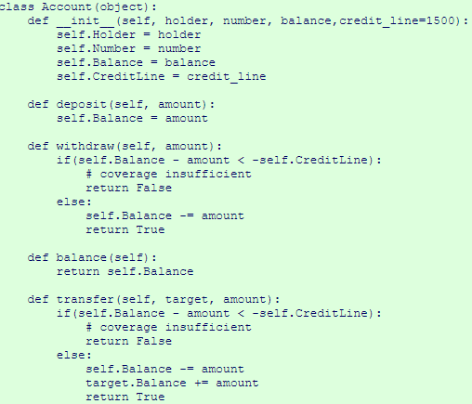
Example class with all methods

Slide 17
Testing class, by importing like a module
>>> import Account
>>> k = Account.Account("Guido",345267,10009.78)
>>> k.balance() 10009.780000000001
>>> k2 = Account.Account("Sven",345289,3800.03)
>>> k2.balance() 3800.0300000000002
>>> k.transfer(k2,1000)
True
>>> k2.balance()
4800.0300000000007
>>> k.balance()
9009.7800000000007
>>>

Slide 18
Classes as types
As we have seen, in Python all variables have a type. We can use the built-in dir function to examine the capabilities of a variable. We can also use type and dir with the classes that we create.
class PartyAnimal:
x = 0
def party(self) :
self.x = self.x + 1
print("So far",self.x)
an = PartyAnimal()
print ("Type", type(an))
print ("Dir ", dir(an))
print ("Type", type(an.x))
print ("Type", type(an.party))
Output:
Type <class '__main__.PartyAnimal'>
Dir ['__class__', '__delattr__', ...
'__sizeof__', '__str__', '__subclasshook__',
'__weakref__', 'party', 'x']
Type <class 'int'>
Type <class 'method'>

Slide 19
Constructor
Constructor is a method which invokes at the time of creating object and constructs object by initializing the data members of class.
class PartyAnimal:
x = 0
def __init__(self):
print('I am constructed')
def party(self) :
self.x = self.x + 1
print('So far',self.x)
an = PartyAnimal()
an.party()
an.party()
Output:
I am constructed
So far 1
So far 2

Slide 20
Destructor
Destructor is a method which destructs the object by destroying members of class. This method is executed when ever the object removed from memory.
Example:
class PartyAnimal:
x = 0
def __init__(self):
print('I am constructed')
def party(self) :
self.x = self.x + 1
print('So far',self.x)
def __del__(self):
print('I am destructed', self.x)
an = PartyAnimal()
an.party()
an.party()
an = 42
print('an contains',an)

Slide 21
I am constructed
So far 1
So far 2
I am destructed 2
an contains 42

Slide 22
Multiple Instances
Multiple instances of class can be created to specify different values for each instance. It creates multiple copies of class and members of class.
class PartyAnimal:
x = 0
name = ''
def __init__(self, nam):
self.name = nam
print(self.name,'constructed')
def party(self) :
self.x = self.x + 1
print(self.name,'party count',self.x)
s = PartyAnimal('Sally')
j = PartyAnimal('Jim')
s.party()
j.party()
s.party()

Slide 23
Output:
Sally constructed
Sally party count 1
Jim constructed
Jim party count 1
Sally party count 2

Slide 24
Data Encapsulation
Name | Notation | Behaviour
name | Public | Can be accessed from inside and outside
_name | Protected | Like a public member, but they shouldn't be directly accessed from outside.
__name | Private | Can't be seen and accessed from outside

Slide 25
Example:
class exam(object):
def __init__(self, a, b, c):
self.p = a # public member
self._pr = b # Protected member
self.__prt = c #Private member
>>> x = exam(11,13,17)
>>> x.p
11
>>> x._pr
13
>>> x._pr= 23
>>> x._pr
23
>>> x.__prt
Traceback (most recent call last): File "<stdin>", line 1, in <module> AttributeError: ‘exam' object has no attribute '__prt'

Slide 26
Class and Object Variables
Class variables are shared by all objects (instances) of that class.
As there is only one copy of an object variable a change of value of such a variable is reflected in all the other instances as well.
Object variables (also called instance variables). These variables can have and usually have different values for different objects.
E.g. Two accounts have different account numbers

Slide 27
Example:
class Account(object):
counter = 0
def __init__(self, holder, number, balance,credit_line=1500):
Account.counter += 1
self.__Holder = holder
self.__Number = number
self.__Balance = balance
self.__CreditLine = credit_line
def __del__(self):
Account.counter -= 1

Slide 28
>>> Account.counter
0
>>> a1 = Account("Homer Simpson", 2893002, 2325.21)
>>> Account.counter
1
>>> a2 = Account("Fred Flintstone", 2894117, 755.32)
>>> Account.counter
2
>>> a3 = a2
>>> Account.counter
2
>>> a4 = Account("Bill Gates", 2895007, 5234.32)
>>> Account.counter
3
>>> del a4
>>> Account.counter
2
>>> del a3
>>> Account.counter 2
>>> del a2
>>> Account.counter
1

Slide 29
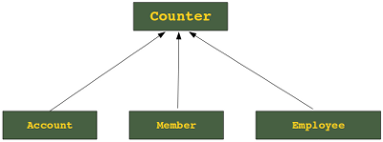
Inheritance
inheriting or transfer of characteristics from parent to child class without any modification”.
The new class is called the derived/child class and the one from which it is derived is called a parent/base class.

Slide 30
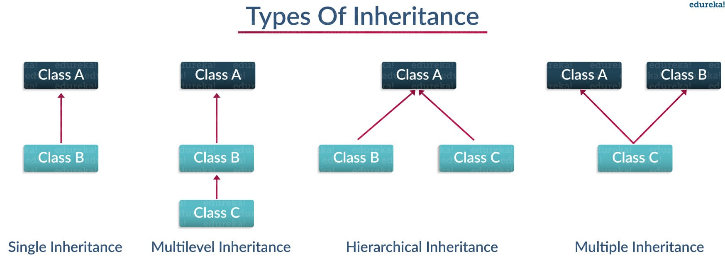

Slide 31
Single Inheritance:
Single level inheritance enables a derived class to inherit characteristics from a single parent class.
Multilevel Inheritance:
Multi-level inheritance enables a derived class to inherit properties from an immediate parent class which in turn inherits properties from his parent class.
Hierarchical Inheritance:
Hierarchical level inheritance enables more than one derived class to inherit properties from a parent class.
Multiple Inheritance:
Multiple level inheritance enables one derived class to inherit properties from more than one base class.

Slide 32
Syntax:
class Subclass(BaseClass):
<class body>
The super( ) method:
super().init() # call super class constructor
super().init(arguments) # call super class constructor and pass arguments
super().method() # call super class method

Slide 33
Single Inheritance
class employee1(): //This is a parent class
def __init__(self, name, age, salary):
self.name = name
self.age = age
self.salary = salary
class parttime(employee1): //This is a child class
def __init__(self, name, age, salary, id):
self.name = name
self.age = age
self.salary = salary
self.id = id
emp1 = employee1('harshit',22,1000)
print(emp1.age)

Slide 34
Multilevel Inheritance
class employee(): //Super class
def __init__(self,name,age,salary):
self.name = name
self.age = age
self.salary = salary
class parttime(employee)://First child class
def __init__(self,name,age,salary):
self.name = name
self.age = age
self.salary = salary
class intern(parttime)://Second child class
def __init__(self, name, age, salary):
self.name = name
self.age = age
self.salary = salary
emp1 = intern('harshit',22,1000)
emp2 = parttime('arjun',23,2000)
print(emp1.age)
print(emp2.age)

Slide 35
Hierarchical Inheritance:
class employee():
def __init__(self, name, age, salary): //Hierarchical Inheritance
self.name = name
self.age = age
self.salary = salary
class parttime(employee):
def __init__(self,name,age,salary):
self.name = name
self.age = age
self.salary = salary
class fulltime(employee):
def __init__(self, name, age, salary):
self.name = name
self.age = age
self.salary = salary
emp1 = parttime'harshit',22,1000)
emp2 =fulltime(‘arjun',23,2000)
print(emp1.age)
print(emp2.age)

Slide 36
Multiple Inheritance
class employee()://Parent class
def __init__(self, name, age,):
self.name = name
self.age = age
class payslip()://Parent class
def __init__(self,da,age,salary):
self.da = da
self.hra = hra
self.salary = salary
class emp_pay(employee,payslip):
def __init__(self, name, age, salary,da,hra):
self.name = name
self.age = age
self.salary = salary
self.da = da
self.hra=hra
emp2 = emp_pay('arjun',23,2000,200,200)
print(emp2.age)
print(emp2.salary)

Slide 37
Types of methods
We can classify the methods in the following
3 types:
Instance methods
Accessor methods
Mutator methods
Class methods
Static methods

Slide 38
Instance Methods
Instance methods are the methods which act upon the instance variables of the class.instance methods are bound to instances and hence called as: instancename.method()
Ex:
class Student:
def init (self,n='',b=''):
self.name=n self.branch=b
def display(self): //instance method
print "Hi",self.name
print "Branch", self.branch
s1=Student()
s1.display()

Slide 39
Instance methods types
Accessor methods simply access of read data of the variables. They do not modify the data in the variables. Accessor methods are generally written in the form of getXXXX( ) and hence they are also called getter methods.
Mutator methods are the methods which not only read the data but also modify them. They are written in the form of setXXXX( ) and hence they are also called setter methods.

Slide 40
Example
class Student:
def setName(self,n):
self.name = n
def setBranch(self,b):
self.branch = b
def getName(self):
return self.name
def getBranch(self):
return self.branch
s=Student()
name=input("Enter Name: ")
branch=input("Enter Branch: ")
s.setName(name)
s.setBranch(branch)
print s.getName()
print s.getBranch()

Slide 41
Class methods:
These methods act on class level. Class methods are the methods which act on the class variables or static variables. These methods are written using @classmethod decorator above them. By default, the first parameter for class methods is „cls‟ which refers to the class itself.
For example, „cls.var‟ is the format to the class variable. These methods are generally called using classname.method( ). The processing which is commonly needed by all the instances of class is handled by the class methods.
Example:
class Bird:
wings = 2
@classmethod
def fly(cls,name):
print name,"flies with",cls.wings,"wings"
Bird.fly("parrot") #display "parrot flies with 2 wings“
Bird.fly("sparrow") #display "sparow flies with 2 wings"

Slide 42
Static methods
We need static methods when the processing is at the class level but we need not involve the class or instances. Static methods are used when some processing is related to the class but does not need the class or its instances to perform any work.
Such tasks are handled by static methods. Static methods are written with decorator @staticmethod above them. Static methods are called in the form of classname.method ( ).
class MyClass:
n = 0
def init (self):
MyClass.n = Myclass.n + 1
def noObjects():
print "No. of instances created: ", MyClass.n m1=MyClass()
m2=MyClass()
m3=MyClass()
MyClass.noObjects()

